Slide 1
INSIGHTS FROM PIZZA SALES DATA
BY
ADEDEJI FIYINFOLUWA
NOVEMBER, 2025.

Slide 2
INTRODUCTION
Pizza sales data was analyzed to find the quickest ways to make more money and run a smoother business.
The main focus was to find out the busiest times and to know the products that made the most money.

Slide 3
SUMMARY AND KEY METRICS
KPI | METRIC | INSIGHT
Total Revenue | $817,860.05 | The overall sales performance is very impressive.
Total Orders | 21350 | The business handles a significant volume of transactions.
Total Pizzas Sold | 49574 | An average of approximately 2 pizzas per order.

Slide 4
PRODUCT PERFORMANCE AND CUSTOMER PREFERENCE
Identifying best and worst sellers is key to menu and pricing strategy.
Performance by Size : Large pizzas are the clear preference, accounting for approximately 46% of total sales revenue.
Dominant Category: The Classic Pizza Category contributes the highest percentage of total sales and volume of pizzas sold.

Slide 5
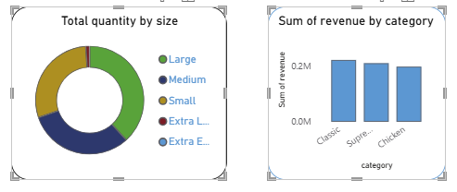

Slide 6
DAILY AND WEEKLY TRENDS
Peak Days: Friday is the busiest day for orders, followed by Thursday and Saturday.
Slowest Days: Sunday and Monday have the lowest order volumes.
Hourly Peaks: Orders peak during the lunch rush (12 PM - 1 PM) and the dinner hours (5 PM - 6 PM).

Slide 7
MONTHLY TREND
Peak Months: Sales peak in the mid-year months, with July and May recording the highest number of orders.
Slow Months: October and September represent the slower sales periods of the year.

Slide 8
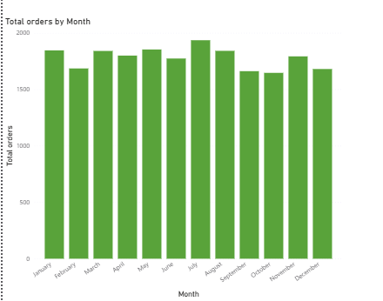

Slide 9
BUSINESS RECOMMENDATION
Increase staffing and pre-prep capacity on Thursdays, Fridays, and Saturdays.
Always ensure an ample supply of Large-sized and Classic Category ingredients
Targeted promotions:
Implement specific deals on Sunday/Monday and targeted seasonal campaigns during September/October.

Slide 10
EXPECTED OUTCOMES
Dynamic staffing will :
Reduce order wait times, minimize stock-outs, and capitalize fully on peak demand days.
Targeted promotions will also help :
Stimulate demand during historically slow days and months to stabilize revenue throughout the year.

Slide 11
CONCLUSION
What was discovered after analysis
The business is sustained by the weekend rush.
Large pizzas and Thai Chicken are the financial backbone.
Resources are being wasted on The Brie Carre Pizza.

